Slide 1
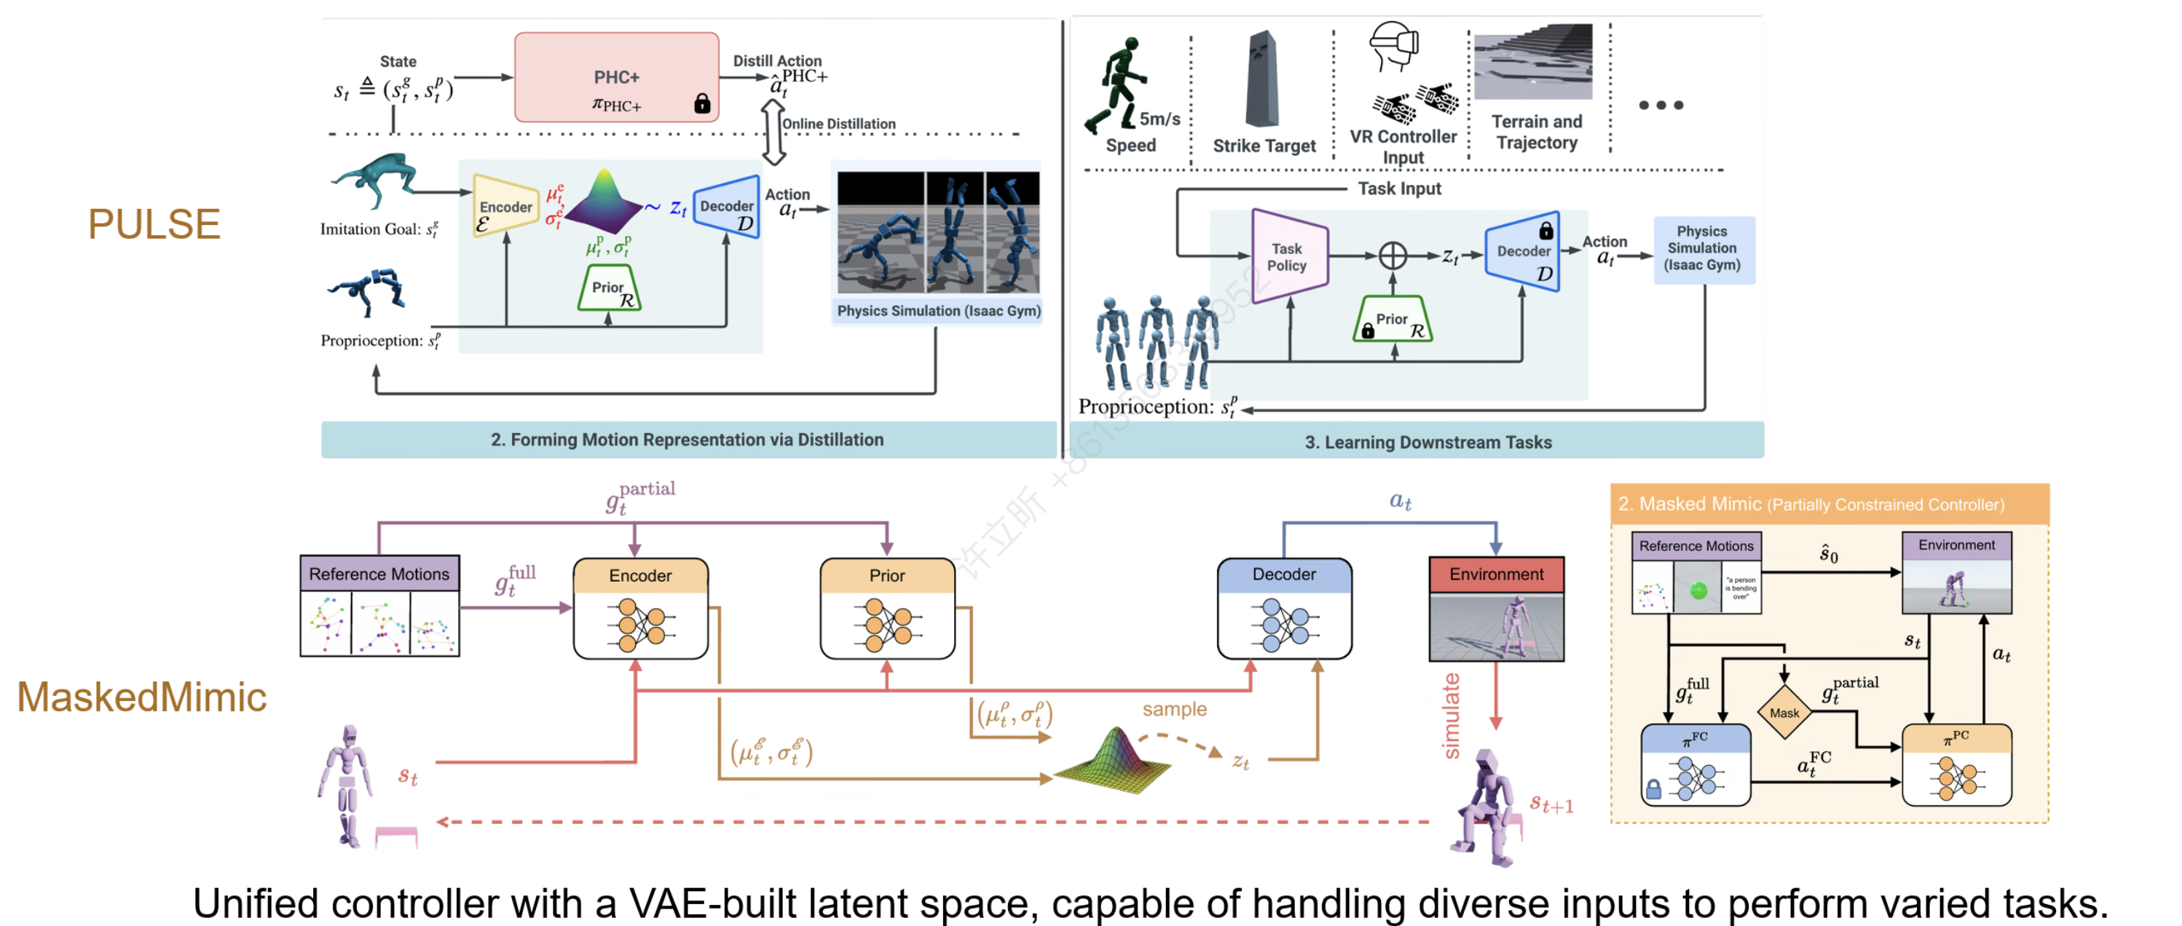
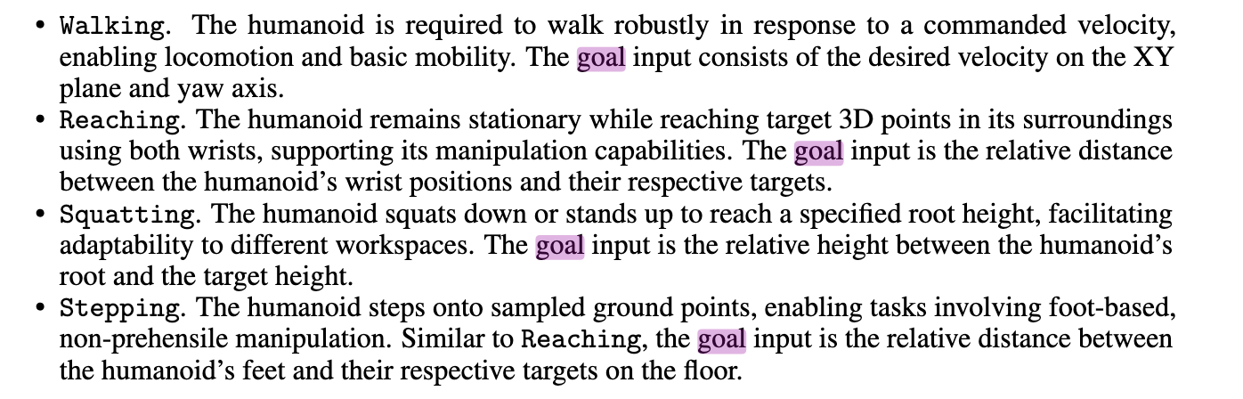
什么的primitive是好primitive，看一下技能的分类
PCA 降维 VAE降维
TSNE降维
Projection & Visualization
[1] Hierarchical and Modular Network on Non-prehensile Manipulation in General Environments
[2] Leland McInnes, John Healy, and Steve Astels. hdb-scan: Hierarchical density based clustering. The Journal of Open Source Software, 2(11):205, 2017.
[3] Leland McInnes, John Healy, Nathaniel Saul, and Lukas Grossberger. Umap: Uniform manifold approximation and projection. The Journal of Open Source Software, 3(29):861, 2018.
goal input:
Push along uneven surface; Time caging
Non-prehensile
Skill Emergence
goal:
Contract (disturbance)
Firm Grasp
Object
Relative 6D motion Sequence
Intention
Encoder
Intention Embedding
Intention
Decoder
Relative 6D motion Sequence
goal:
In-hand rotation,
In-hand translation
In-hand Adaptation
DexHand
loss
Approaching Object, move after grasp
Wrist Movement
最好是有明显的groupping，到时候sample对应的group的intention，就可以guide手做出对应的动作，用moe
implicit: latent space
explicit: one-hot
skill discorvery
cond.
需要想一想，embedding of sequence， 还是embedding of pose
现在的画法是embedding of pose
lower level skill collection
Synergy
Encoder
Synergy Embedding
Synergy
Decoder
Observation
joint states
fingertip 3d pose
object 6d pose
object 6d velocity
Non-prehensile Reward
Firm Grasp Reward
Observation
Agent
Gating
Action
Agent
Synergy
Decoder
Agent
Synergy
Decoder
In-hand
Reward
Synergy
Decoder
Global Object
Point Cloud
PointCloud 的最大意义不是过encoder， 而是和hand point进行有意义的matching
SAM2
Foundation Pose
Local Object
Point Cloud
Local Hand
Point Cloud
batch_sided_distance
Imitation Learning Pretrain
Data Flywheel

